Slide 1
Making Reliable Lab Apps: Demystifying Good Software Engineering Practices
Stephan Kadauke, MD, PhD
Assistant Professor of Pathology and Lab Medicine
Children’s Hospital of Philadelphia
AACC Atlanta, 30-Sep-2021
Notes:
[[Set up web sites:
Demo 1: https://rstudio-connect.chop.edu/content/2053/?test_data=true – enter 80000001 and click on first row
Demos 2-4: https://github.research.chop.edu/CGTDataOps/cibmtrFormsAssistant
]]
Thanks very much to the organizers for having us here. My name is Stephan Kadauke, and I’m calling in from Philadelphia. I’m an Assistant Professor of Pathology and Lab Medicine at the Children’s Hospital of Philadelphia, where I co-direct the Cell and Gene Therapy lab, and where I have also built and deployed a number of custom applications written in R. The title of my piece of this session is…
Also, right off the bat I wanted to let you know right here that there’s no need to take notes, I’ll make these slides available for download after the session.

Slide 2
Conflicts of Interest
None

Slide 3
Learning Objectives
After this session, participants will be able to:
Define “production” as it relates to software
Explain the role of software engineering practices to mitigate risks inherent in developing software for production
List three common software engineering practices that should be routinely employed when building custom lab apps
Notes:
My goal is to teach the basics of good software engineering tailored to an audience of clinical laboratorians who may be involved in overseeing a software development project but who don’t necessarily know how to program themselves.
After this session, …

Slide 4
Case Studies
Notes:
Let’s start with two motivating case studies--

Slide 5
Case 1
A very smart lab director taught himself programming in R.
Using his R skills, he develops multiple applications that automate various workflows in the chemistry lab.
The applications are hosted on a server in the hospital’s data center. On a Friday afternoon, the server is upgraded, and all apps go down.
He spends the weekend fixing the apps.

Slide 6
Case 2
An apheresis director built a database using Microsoft Access to serve the operational needs of the service. This happened back in 2001.
To this day, this database serves as the de-facto information system for the apheresis service.
Over the years, she has extensively customized the database. It now contains many features that are no longer being used, and others that are essential for day-to-day activities of the apheresis service.
This individual, who is the sole maintainer, is now nearing retirement.

Slide 7

Notes:
So I hope that these case studies, both which are taken from my own experience and only slightly modified, illustrate, is that there are some risks in building custom software for the lab.
And those risks can creep up on you. You may feel like everything is fine but all of a sudden realize that the room is on fire.
So my talk is about ways of dealing with that risk.

Slide 8
Demo
Notes:
https://rstudio-connect.chop.edu/content/2053/?test_data=true
8000001
I want to show you an example of a clinically used app my team built.
Point out:
- This is an app written in R that our data managers use to determine neutrophil (or ANC) and platelet recovery after hematopoietic stem cell transplant. There’s a legal requirement to report these metrics to a registry called the CIBMTR.
There are multiple complex calculations, and they need to be correct, and our data managers rely on the information being correct.

Slide 9
Production
Notes:
So what do I mean by production?

Slide 10
What is “Production”?
An application is said to be in production if the following are true:
It is being used, even if only by one person.
It is being relied upon by its user(s).
It has real life impact if something goes wrong.
Engineering Shiny (Fay et al., 2021)

Slide 11
Which of the following applications are in production?
A Blood Bank director writes an app to help triage platelet units. She wrote the app, and she is the only person using the app.
A testing instance of Epic is deployed that will be used to evaluate issues that may come up during an upcoming EHR upgrade.
A physician writes an app that checks his work computer for large files. The app runs daily and sends him an email listing all files larger than 1 GB.
Notes:
So to hammer this idea home, let’s look at a few scenarios, and I want you to tell me which of the following apps are in production.
And since we’re a mix of live and virtual, here’s what I suggest. If you’re attending live, and we’re running a little low on time, I’m going to ask you to think of the answer in your head; if you’re attending virtually, please post the answer in the chat!
#1 - Yes! It doesn’t matter than she’s the only user. She relies on it, and things could go wrong if the app doesn’t work correctly.
#2 - No! Testing only. No real life impact if things go wrong. You actually want things to go wrong here.
#3 - Probably no. There isn’t a really bad impact if this stops working.

Slide 12
Software Engineering
Notes:
Now that we have covered the concept of Production, let’s switch gears and talk about Software Engineering, which is a set of practices that allow building production grade software.

Slide 13
The Cliff of Complexity
Usually, a small app that is useful does not stay small.
You add a feature
Then another
Eventually, it will become too complex to understand how all pieces fit together
At this point, you may be afraid to make any changes for fear that they will break something
https://www.teahub.io/viewwp/iiboixi_japanese-scenery-wallpapers-cliff-fantasy-art/
Notes:
…
And I think this cliff of complexity is really something you become viscerally aware of when you’re afraid to change an order set or a lab information system because you’re afraid of the downstream effects. So complexity is directly tied to the risks of building custom software.

Slide 14
Software Engineering
IEEE: The application of a systematic, disciplined, quantifiable approach to the development, operation, and maintenance of software
Software engineering is the art of building maintainable software, and it does so in large part by employing practices that reduce complexity of writing, reviewing, and deploying code.
Notes:
So, why do I talk about complexity, and what does that have to do with software engineering?
When you look at the definition of software engineering by the Institute of Electrical and Electronics Engineers, what they say is that it’s the application of a systematic, disciplined, quantifiable approach to the development, operation, and maintenance of software
I find the following definition more useful, which is that Software Engineering is the art of building maintainable software, and it does so in large part by employing practices that reduce complexity of writing, reviewing, and deploying code. So we acknowledge that there is some inherent complexity but we do our future selves a favor, and we reduce risk, when we try to reduce complexity where we can.

Slide 15
Software Engineering Practices
Version Control
Automated Testing
Code Review
…
Notes:
I next want to introduce three of the most widely used software engineering practices, namely Version Control, Automated Testing, and Code Review. Each of these techniques has a steep learning curve but in the long term reduces the complexity of building and maintaining software.
So do you your need to learn all of this in addition to running your clinical lab? As Amrom said earlier, you’re a doctor not a programmer!
No! But if you’re a stakeholder in a project that involves building an application it may be a good idea to have a working understanding of what they are and what their purpose is.

Slide 16
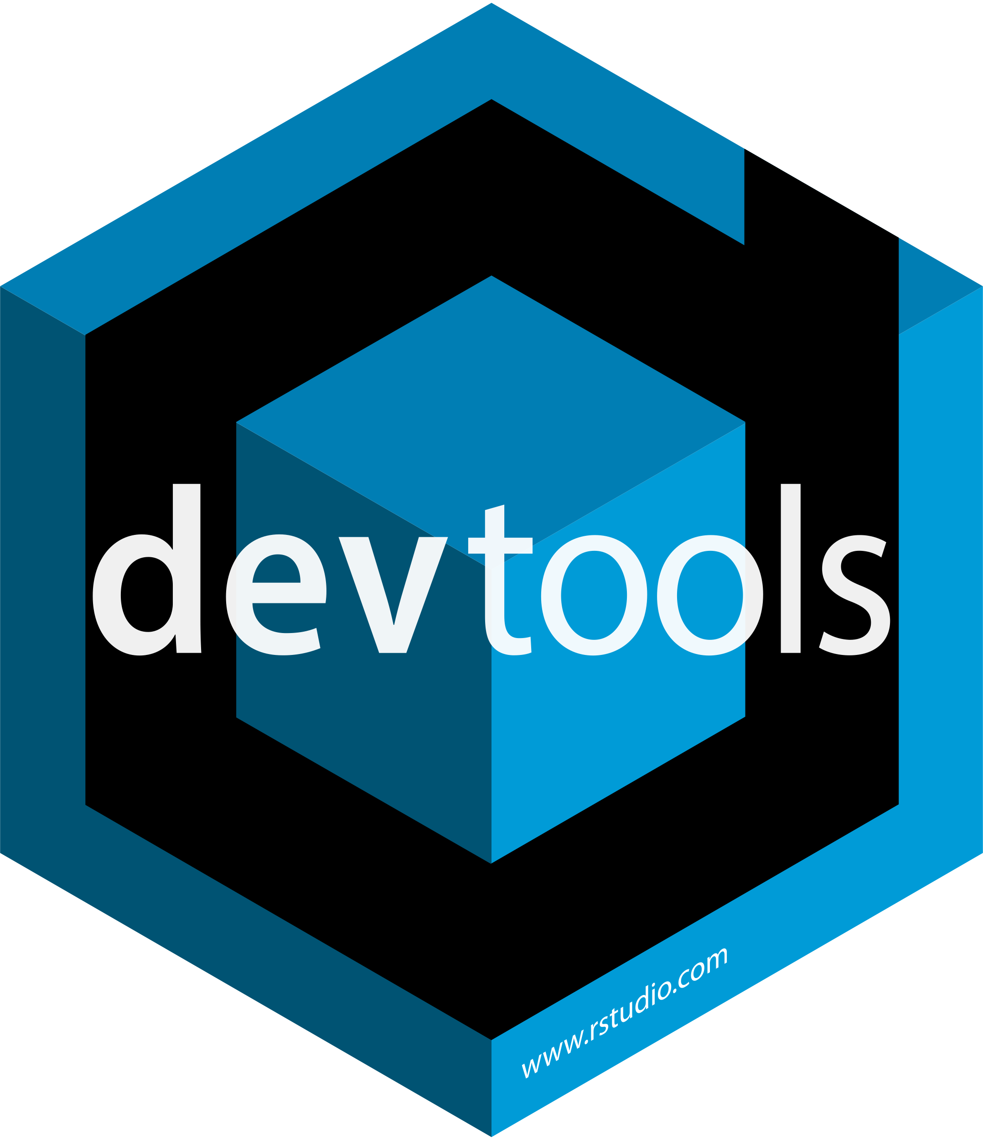
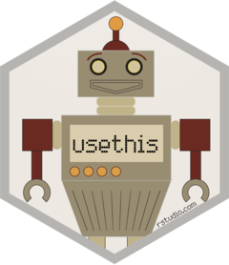
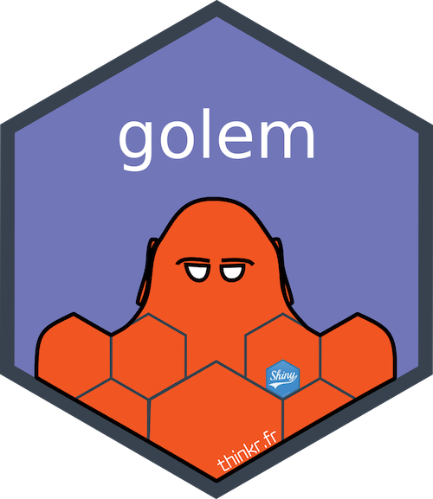
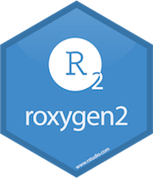

Notes:
And this slide is just to remind me to mention that there is an entire ecosystem of high quality and user-friendly free R packages that support good software engineering practices.

Slide 17
Version Control
Notes:
So let’s talk about Version control.

Slide 18

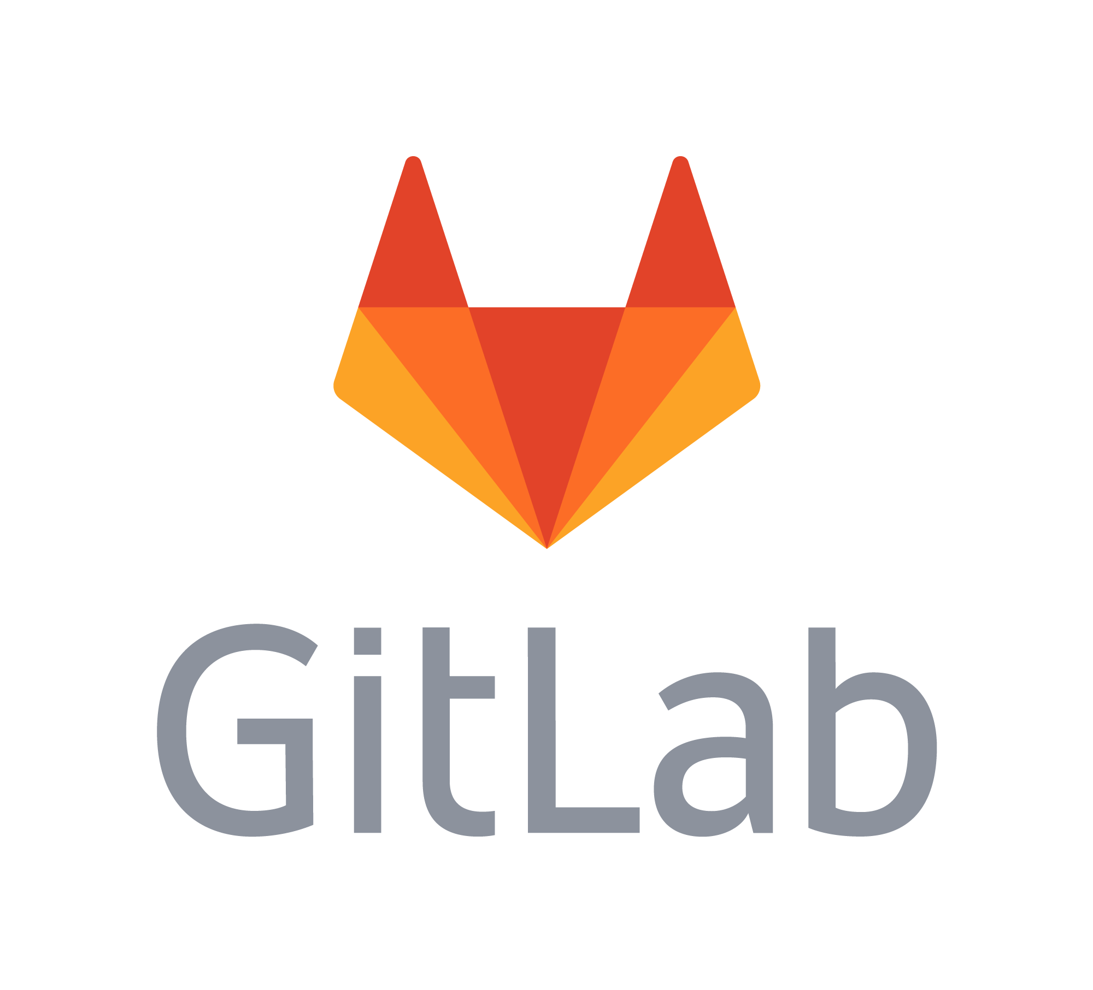
What is Version Control?
A set of practices that enable change control and collaboration for software code.
Branch
Your Work
Merge
Repository
(“Repo”)
Main
Commit
Time
Someone Else’s Work
https://www.nobledesktop.com/blog/what-is-git-and-why-should-you-use-it
Notes:
Version control is the most complex of the three techniques I’m going to cover, but also one that I think you’ll really want to understand on a conceptual level.
At its most basic, version control is a set of practices that allows for change control and collaboration in software development. A version control system is a program that runs on a server on the web that allows you to store your code. In some ways a VCS is like an electronic document control system that you might use to store your SOPs or departmental policies. The most common VCSs are GitHub and GitLab, and these are their logos, respectively.
So let’s take a look how a VCS works. All of the code and other files relating to a specific software project lives inside a repository or repo. You can think of a repo as a folder on your computer. However, a repo does more than storing files – it also tracks changes to the files in the project, (**) building a history as well as an audit trail over time.
So let’s say (**) this green circle represents the state of the files in your project at some point in time. And let’s say you make some changes to the files, you add some, rename others, and delete some, and then you update your VCS, that will create a (**) new state (so you get a new green circle). The process of updating your repository with changes is called a (**) commit. So you’d say you committed some changes to the repo. Over time, you can see how successive commits create a (**) history of your project. This means you can go back in time -- indefinitely – to a previous state, and you can see who made a specific change and when.
So this is how a VCS allows you to do version control. But what about collaboration? All modern VCSs support collaboration using a mechanism called branching. In fact, the history we just looked at is usually called the (**) Main or Master branch. But you can make (**) additional branches that represent independent lines of development. The process of reconciling changes in divergent branches is called a merge. And one thing that’s amazing is that most of the time this works automatically even if two different people have changed the same file. So (**) different people can work on the same code base at the same time, and this dramatically reduces the complexity inherent in having multiple people contribute to a software project.

Slide 19
Your Turn!
A?
Branch
Commit
Merge
B
A
C
Main
B?
C?
Notes:
So let’s do a quick Your Turn!
We discussed three types of transitions between states in a repository, the branch, the commit, and the merge. Which one does A represent? What about B? Or C?

Slide 20
Demo
Notes:
Show the Engraftment app’s repo
https://github.research.chop.edu/CGTDataOps/cibmtrFormsAssistant
Point out:
GitHub is accessible from a browser and is actually pretty user friendly.
We have Github Enterprise instance, which means that I can store code behind CHOP’s firewall.
Branch = master
Repo for the cibmtrFormsAssistant lists all the files in the current branch, and I can easily download all the files to my computer.
You can also see that there are XXX commits in the history. When I click on the commits I see a timeline that tells me who committed the code and when and also a commit message that is a one-liner explanation of what’s going on in a specific commit.
From here I can do two more things: 1) I can browse the repo at that previous state, and 2) I can see which lines in each file actually changed. Green = additions, red = deletions. So you’ll get an automated Track Changes view that allows you to navigate your version history. Pretty powerful!

Slide 21
Other benefits of using a VCS
Can roll back the application to a previous known working state
Can trigger automated tests and code review

Slide 22
Automated Testing

Slide 23
What is Automated Testing?
A key mechanism of quality control in software development.
Two main types of tests
Unit tests are small pieces of software designed to check the logic of small independent pieces of functionality in the code.
Yes, we write code to test code
No, we don’t write code to test the code that tests the code!
Unit tests reduce complexity by un-coupling: they force the programmer to build small independent modules of code
Integration tests exercise multiple modules of code together.
It usually takes fewer than ten minutes to run all tests
Notes:
…
A medium-size software project often contains a hundred or more automated tests.
It usually takes fewer than ten minutes to run all tests, making it feasible to exercise the test suite frequently.

Slide 24
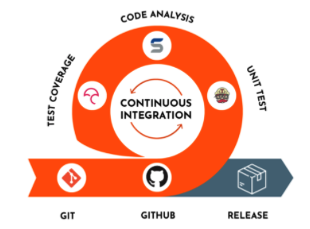
Continuous Integration
https://www.devonblog.com/continuous-delivery/continuous-integration-best-practices/
Notes:
You can integrate automated testing with version control systems, and this is known as continuous integration. If you set up continuous integration for your project, each time you update your repository, the VCS triggers a run of the entire test suite, and if anything fails you’ll get a notification telling you exactly which test failed.

Slide 25
Demo
Notes:
https://github.research.chop.edu/CGTDataOps/cibmtrFormsAssistant/
Show the tests folder and browse to tests/testthat/test-fct_anc500_day.R
This file contains a unit test that tests the function that calculates the neutrophil engraftment date. This function is called anc500_day().
Point out:
- Highlighting rows 39 - 47
Unit test typically consists of two steps:
Step 1: Call the function with test data that I know should produce an expected result if the function works correctly
Step 2: Check that you got the expected result
If you don’t get the expected result, the test fails and you get an email telling you specifically which test failed
If all tests pass, you’re good to go.
Show Actions – point out checkboxes and that running tests took <10 min

Slide 26
Code Review
Notes:
Let’s move on to Code Reviews!

Slide 27
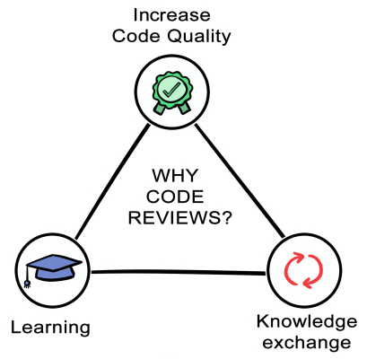
What is Code Review?
A kind of peer review in which someone other than the person who wrote the code looks at the source code and adds their comments and/or approval.
https://quickbirdstudios.com/blog/code-review-best-practices-guidelines/
Notes:
…
And why do we do code reviews? Because they’ve been shown to
1. Increase code quality: You’re going to do a better job writing your code if you know someone else will look at it and that you might have to explain what you did. This reduces complexity by encouraging programmers to write clear code and good documentation.
2. Increase learning when you’re onboarding a new team member
3. Facilitate knowledge exchange: by having more than one person look at any piece of code, you avoid the problem that there’s only one maintainer which I highlighted in the two case studies in the beginning.

Slide 28
Pull Request
A pull request lets others know that you would like to merge your changes to the main branch.
Pull Request
Merge
Main
Notes:
Code review can be integrated into the workflow of a version control system, and that’s called a Pull Request.
A pull request lets others know that you would like to merge your changes to the main branch.

Slide 29
Demo
Notes:
So let’s look at a recent pull request from the Engraftment app. (Show PR #20)
A key piece is the timeline which contains comments and other events
Here the developer tells me about the changes he has made.
I can see that there are a number of commits that have been made. The last one has a checkmark, and this tells me that continuous integration has run and all unit tests have passed at this time.
Then he requested a review from me.
Knowing that all the tests worked in the current version of the code makes my life a lot easier! Because now I don’t have to look for syntactic errors and can instead focus on whether the logic is sound and the code is clearly written
Click on “View Changes” – can see all the changes. GitHub is smart enough to show me all the changes from all the relevant commits for this pull request.
Allows me to verify that he made exactly the changes we had discussed and how.

Slide 30
Recap

Slide 31
Learning Objectives
After this session, participants will be able to:
Define “production” as it relates to software
Explain the role of software engineering practices to mitigate risks inherent in developing software for production
List three common software engineering practices that should be routinely employed when building custom lab apps

Slide 32
Recap
An application in production if it is being used, even if only by one person; it is being relied upon by its user(s); and it has real life impact if something goes wrong.
Software engineering is the art of building maintainable software, and it achieves this largely by reducing complexity of writing, reviewing, and deploying code.
Key software engineering practices include using a version control system, automated testing, and code review.

Slide 33
Recap, continued
A Version control system stores code in repositories. A commit is a transition from one state of the repository to the next. Branching allows multiple independent lines of development in a repository. Merging is the process of reconciling divergent branches.
Automated tests provide quality control for software. Unit tests exercise small independent pieces of functionality. Integration tests exercise multiple modules of code together. In continuous integration, tests are triggered whenever a change is made to the repository.

Slide 34
Recap, continued
Code review is a kind of peer review in which someone other than who wrote the code reviews it and adds comments and/or approves it. A pull request is a mechanism that allows a contributor to ask for a code review prior to a merge.
Notes:
Again, you don’t have to master these tools.
But having a basic understanding of these practices really can empower you to ask probing questions. If you are responsible for the outcome of a project that involves building an production-grade application, it will pay off to pay attention to software engineering practices!

Slide 35
Thank You!
E-mail me at:
KadaukeS@chop.edu

